Slide 1
Module 7: Configuring Guided Navigation Links
Analytics: Application Developer (Siebel 7.7)
Notes:
Time: Lecture: 25 – 30 minutes; labs: 15 – 20 minutes
Intent: This module teaches students how to added guided navigation links to Analytics dashboards.
Flow: The module starts with a definition of guided navigation, then progresses to discuss the three types of guided navigation.
Key Terms:
Static links
Conditional links
Conditional sections
7

Slide 2

Module Objectives
After completing this module you will be able to:
  Provide context and intelligent links to logical next links within Intelligence Dashboards
  Identify different types of guided analytics
  Construct guided analytics functionality for an analytics request
Why you need to know:
  Guided navigation enables analytics users to gain insight faster
Notes:
Each objective and “why you need to know” should be stated aloud.

Slide 3
Guided Navigation
Assists users in their exploration of results obtained from Siebel Answers requests
  Provides insight into business issues by allowing users to navigate to a related set of results, another dashboard, or a URL
  Identifies appropriate actions to take based on results
Notes:
Guided navigation can aid users' insight into business issues and appropriate actions to take by guiding their exploration of results obtained from Siebel Answers. When based on common scenarios and best practices for your industry or organization, guided navigation allows users to see and analyze related issues by navigating to a related set of results, another dashboard, or a URL.
A good way to think about Guided Navigation links is to think about a senior user looking over the shoulder of a novice user and providing advice. As industry experts, the students will know the common scenarios and best practices for their areas and can embed these in their dashboards.
7

Slide 4
Types of Guided Navigation
0/3
Guided navigation using static links
Guided navigation using conditional links
Guided navigation using conditional sections
Notes:
This is a structuring slide. Do not teach the steps or concepts here because the following slides cover them in detail.

Slide 5
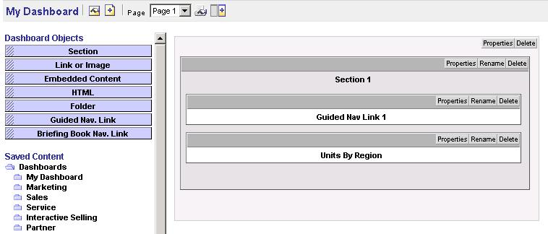
Guided Navigation Using Static Links
1/3
Always include a link to another request, a dashboard, or URL
Drag
Guided Nav object
Click Properties to create the static link
Notes:
When specified for a request, the results on the dashboard always include a link to another request, a dashboard, or URL. For example, a report that shows customer satisfaction gap trends can always appear with a link to a report that shows customer satisfaction by product line. Static links have very little impact on dashboard rendering time.
7

Slide 6
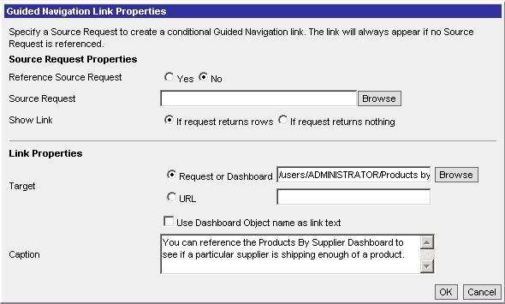
Guided Navigation Using Static Links: Properties
1/3
Use the Caption text box to add explanations for the link
Target link can be a request, dashboard, or URL
Select No for static
This section defines the link
Notes:
If a URL is used, it should be fully qualified. That is, use http://www . . .

Slide 7
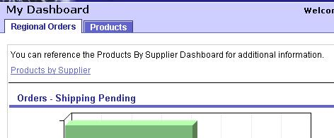
Guided Navigation Using Static Links: Dashboard
1/3
Static links always appear on the dashboard
Static Guided Navigation link
Notes:
The link can be the Web Catalog object name or can be the dashboard object name.
7

Slide 8
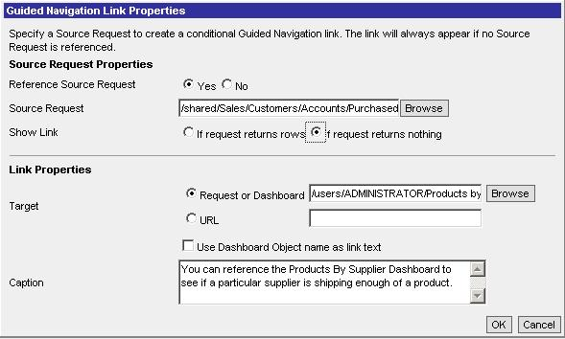
Guided Navigation Using Conditional Links
2/3
Only appear if the source request meets certain criteria
Target link can be a request, dashboard, or URL
Select Yes for conditional
Show link if condition is met
This section defines the link
Caption appears in dashboard if condition is met
Notes:
When specified for a request, a link to another request, dashboard, or URL appears only if the results meet certain criteria. For example, if the number of open critical service requests exceeds a certain threshold, the result set can include a link to a report that shows customer satisfaction by employee. Because the conditional link is based on running a request, a conditional link can impact dashboard rendering time. Use wisely.
To use the dashboard object name for the link text, click the Rename button after closing the Guided Navigation Link Properties dialog box. The text you enter in the Rename text field will be the link text.

Slide 9
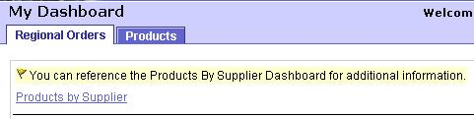
Guided Navigation Using Conditional Links Continued
2/3
Conditional link is highlighted when it appears
Conditions in the referenced request were met
Notes:
If, after the request is run, the condition is not met, the conditional link will not appear.
7

Slide 10
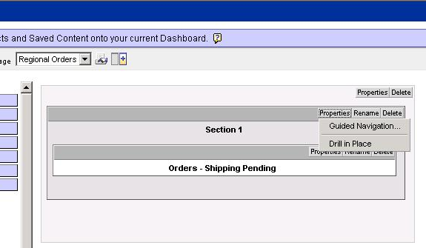
Guided Navigation Using Conditional Sections
3/3
Entire dashboard sections can be displayed for a particular request based upon the results returned by Siebel Answers
1. Click Properties for the section
2. Select Guided Navigation…
Notes:
Entire dashboard sections can appear based upon the results returned by Siebel Answers for a particular request. For example, if the results show that sales are down by 15 percent or greater in the past week, a dashboard section that contains links to related reports and tools can appear.

Slide 11
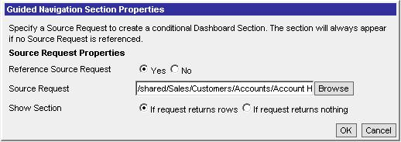
Guided Navigation Using Conditional Sections Continued
3/3
Set the Reference Source Request property to Yes to have the section appear based on the results of a request
Set the condition
Notes:
Similar to conditional links, setting a conditional section can impact performance.
7

Slide 12
Summary
This module showed you how to:
  Provide context and intelligent links to logical next links within Intelligence Dashboards
  Identify different types of guided analytics
  Construct guided analytics functionality for an analytics request
Notes:
Review Questions:
Question: Static Guided Navigation links slow down dashboard rendering time. True or false?
Answer: False; the display of static links does not generally affect dashboard rendering time. The display of numerous conditional links or sections can affect dashboard rendering time.

Slide 13
Lab
In the lab you will:
  Add guided navigation to a dashboard
Notes:
Labs and Troubleshooting:
See Lab Guide for details.
7

